Slide 1

HS 2015
Current Trends in Distributed Systems
Final presentation
Group:
Patrick Zumsteg
Simon Wallny
Philipp Oldenburg

Slide 2
Structure
Here
There
Be
Topics
Classification
3rd Party Libraries
HS 2015
Current Trends in Distributed Systems – Final presentation
<Nummer>

Slide 3
Classification
Linear Classifier
  Naive Bayes
8-dimensional feature space
  Temperature
  Wind speed
  Air pressure
  Humidity
  Δ Temperature
  Δ Wind speed
  Δ Air pressure
  Δ Humidity
HS 2015
Current Trends in Distributed Systems – Final presentation
<Nummer>

Slide 4

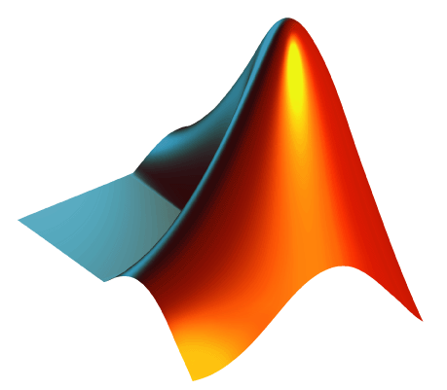
Classification
Training in MatLab
Classifying in Java
HS 2015
Current Trends in Distributed Systems – Final presentation
<Nummer>

Slide 5
3rd Party Libraries
ejml (Efficient Java Matrix Library)
JMatIO
HS 2015
Current Trends in Distributed Systems – Final presentation
<Nummer>

Slide 6
HS 2015
Current Trends in Distributed Systems
Final presentation
Group:
Patrick Zumsteg
Simon Wallny
Philipp Oldenburg

